Slide 1
Local Government

Slide 2
City Council
City Council consists of a _________ and _________ Councillors, elected for a term of _________ years. The position of Mayor and _________ are at-large elections, meaning that each person _________ represents the City as a whole and not a particular ward or section of the City.
Word Bank
Eight
Councillors
Elected
Four
Mayor

Slide 3
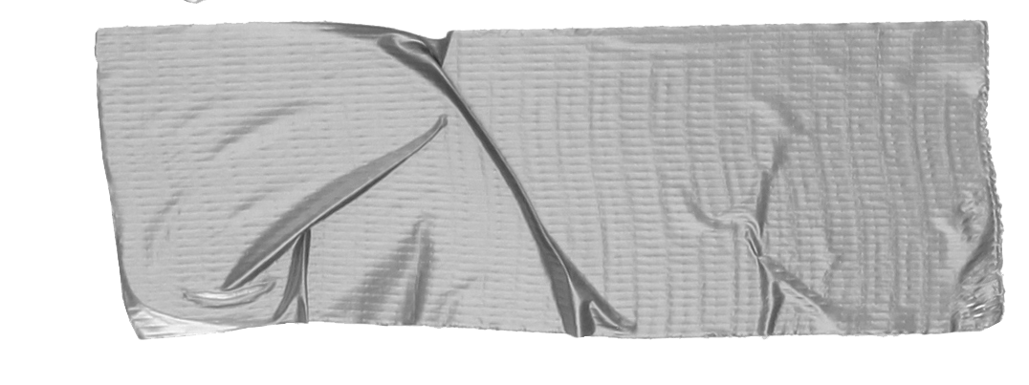

Word Bank
Operations
Employees
Municipal
Councillor
Mayor
The Municipal Government Act sets out the powers of _________ governments. The Mayor is the Chief Elected Official of the municipality and has duties as both _________ and _________. The Chief Administrative Officer of the City is in charge of day-to-day city _________ and _________.

Slide 4
Let’s meet our Medicine Hat city council members!
Link
http://www.city.medicine-hat.ab.ca/index.aspx?page=70

Slide 5
City Council Meetings
Our city council meets every two weeks. What happens in these meetings? What do they talk about?
Link
https://www.youtube.com/watch?v=ISbLHV9mO-c&feature=youtu.be

Slide 6
Election Time!
Medicine Hat’s last election was in 2013. The 2013 election was held on _________. _________ voted for candidates in the following races:
Mayor (_________ candidate)
Councillor (up to _________ candidates)
Public School Board Trustee (up to _________ candidates)
Word Bank
One
Five
October 21, 2013
Residents
Eight

Slide 7
Are You Interested in Running for Mayor?
The next Municipal General Election is on October 16, 2017

Slide 8
Who Can Vote?
You must be at least _________ years old
You must be a _________ citizen
You must have been a resident of Alberta for at least _________ months immediately preceding Election Day and
Your place of residence (the place where you eat, sleep and intend to return to when away) is located in the area of _________ on Election Day.
Word Bank
Six
Medicine Hat
Canadian
Eighteen

Slide 9
Remember!
In God’s eyes Miss Resch and Mrs Swanson are equal. In the Bible it says: “For the Lord your God is God of gods and Lord of lords, the great God, mighty and awesome, who shows no partiality and accepts no bribes” Deuteronomy 10:17. This means that God could not choose one of them that is better than the other. Each individual running for mayor is equal. But some people are better for running the city. We have to choose a mayor based on their credentials, not based on who our favourite is.
Mock Election Time!
We will be practicing the voting part of the local election. Miss Resch and Mrs. Swanson are running for mayor. They are both great candidates and would be great for the city of Medicine Hat. Who will you vote for on your ballot?

Slide 10
City Council Responsibilities
The city council is _________ for making Medicine Hat a better city and for taking care of our city’s citizens. To achieve this, the city council created a Strategic Plan. Medicine Hat City Council _________ Plan 2014-2018, focuses on:
Growing the _________ (how much money our city makes)
Providing an excellent quality of _________ for our citizens
Being the _________ government possible
Word Bank
Economy
Best
Responsible
Strategic
Life
In Charge
Plants

Slide 11
Has Mayor Ted Clugston fulfilled his responsibilities?
Read the article and find out what our Mayor has done for homelessness. Is this a good example of him providing his citizens with an excellent quality of life?

Slide 12
Word Bank
City
Water
Waste
Vote
Hard
Donate
Pray
Work
Give
Contribute
What Responsibilities Do I Have as a Christian Citizen?
When you are of legal age, you are responsible to _________ for who you think should run the city
Build community
Take care of our _________!
  Dispose of _________ properly
  Recycle
  Conserve _________
_________ for those in need
_________ to Medicine Hat
  _________ used items
  Work _________
http://www.city.medicine-hat.ab.ca/index.aspx?page=1579

Slide 13
How many people voted in Alberta last election?
44.54%
That’s only
34,260 Albertans out of
76,911 in total!
We all need to vote!

Slide 14
Issues
An issue is a problem that is happening in a city. All cities have problems that arise.
What are some examples of issues that occur within cities?

Slide 15
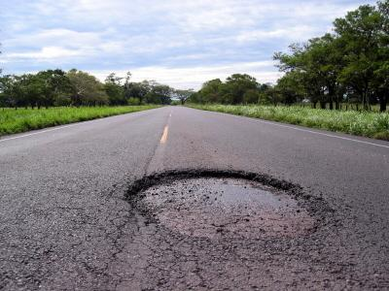
Potholes

Slide 16

Speed Signs

Slide 17
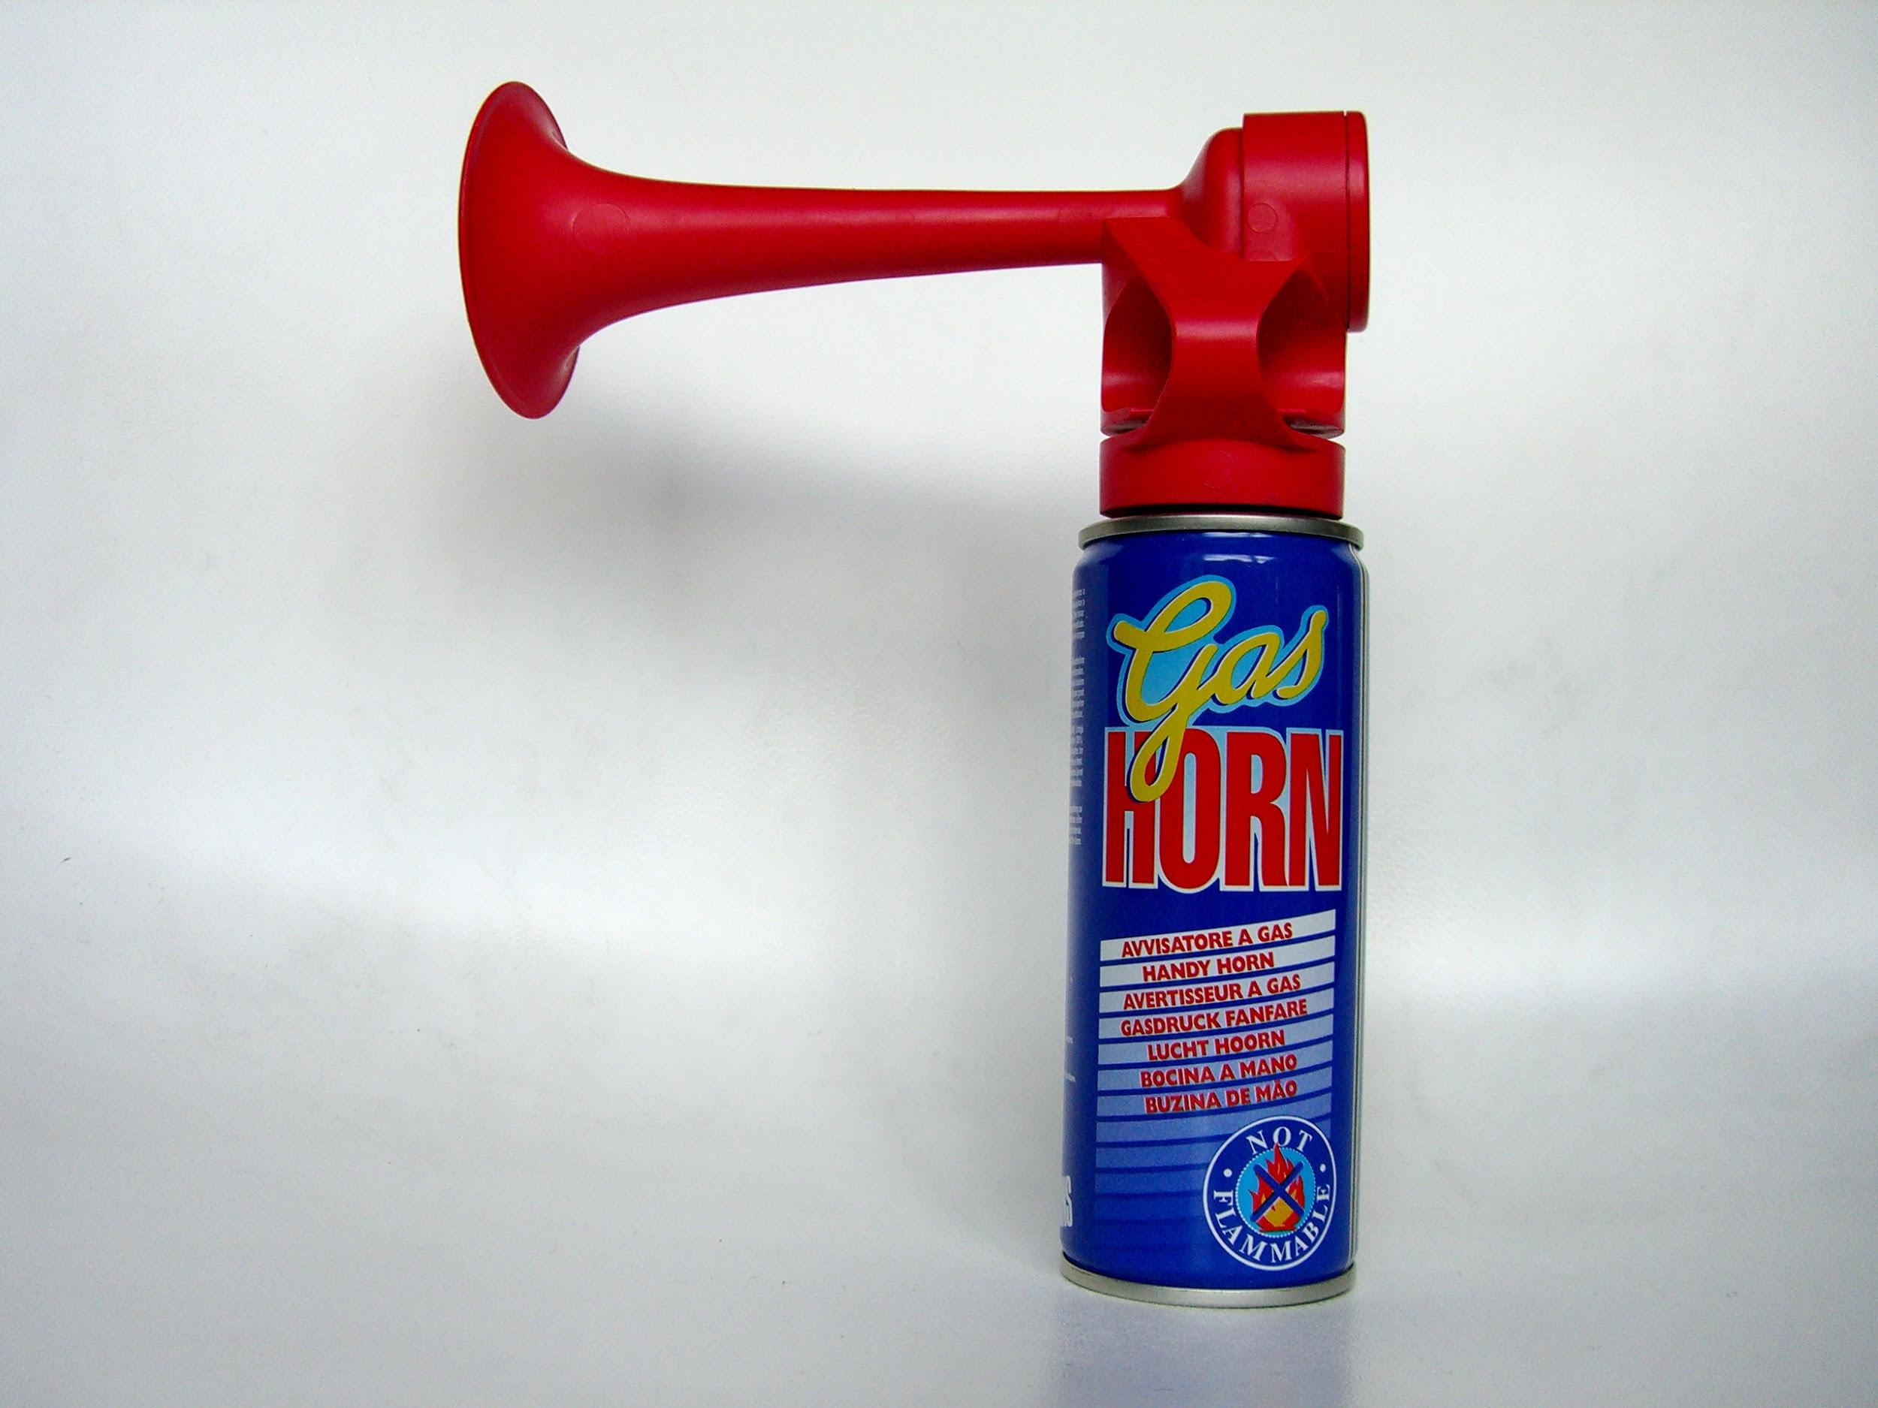
Noise Standards

Slide 18
Why would citizens want these issues taken care of?

Slide 19
Pretend that you are the mayor of Medicine Hat. How would you handle the cities issues?
http://www.city.medicine-hat.ab.ca/index.aspx?page=1

